Slide 1
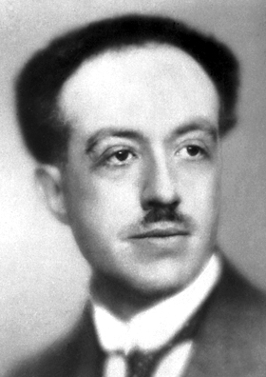
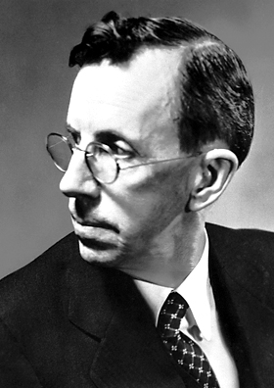
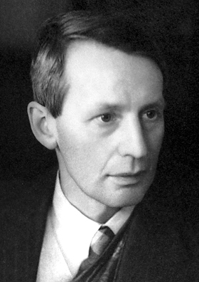
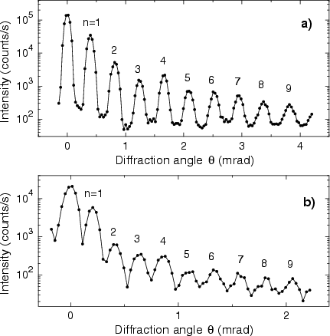
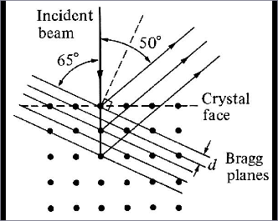
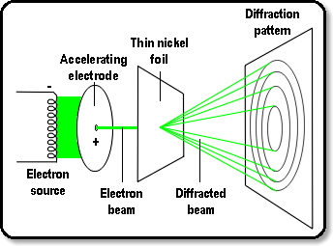
Wave Nature of Matter

Slide 2
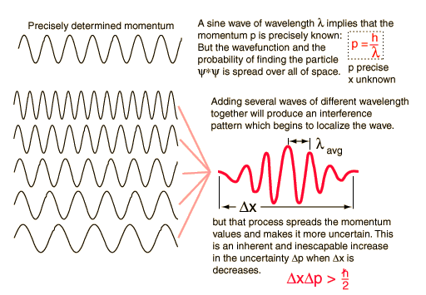
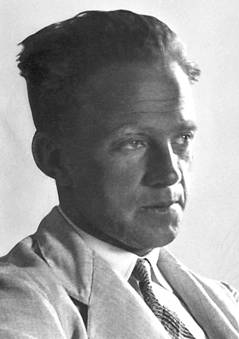
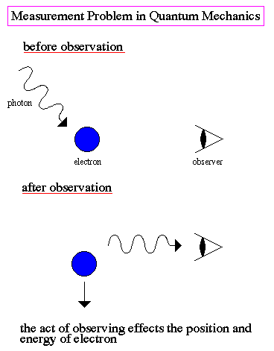
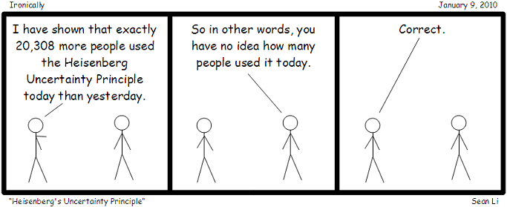

Uncertainty Principle
Uncertainty principle

Slide 3
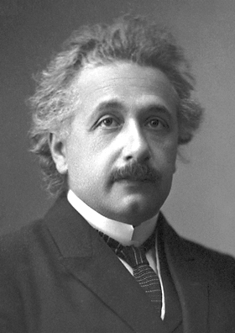
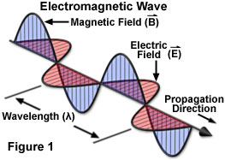
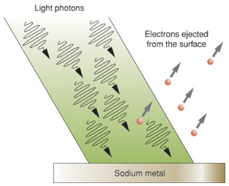
Photoelectric Effect: Wave –Particle Duality
Electromagnetic Radiation
Wave energy is related to Intensity
I ∝ E²₀ and is independent of ω
Einstein borrowed Planck’s idea that ΔE=hν and proposed that radiation itself existed as small packets of energy (Quanta)now known as PHOTONS
φ = Energy required to remove electron from surface

Slide 4
Diffraction of Electrons : Wave –Particle Duality
Davisson-Germer Experiment
A beam of electrons is directed onto the surface of a nickel crystal. Electrons are scattered, and are detected by means of a detector that can be rotated through an angle θ. When the Bragg condition
mλ = 2dsinθ was satisfied (d is the distance between the nickel atom, and m an integer) constructive interference produces peaks of high intensity

Slide 5
Diffraction of Electrons : Wave –Particle Duality
G. P. Thomson Experiment
Electrons from an electron source were accelerated towards a positive electrode into which was drilled a small hole. The resulting narrow beam of electrons was directed towards a thin film of nickel. The lattice of nickel atoms acted as a diffraction grating, producing a typical diffraction pattern on a screen

Slide 6
de Broglie Hypothesis: Mater waves
Since Nature likes symmetry,
Particles also should have wave-like nature
De Broglie wavelength
Electron moving @ 10⁶ m/s
He-atom scattering
Diffraction pattern of He atoms at the speed 2347 m s⁻¹ on a silicon nitride transmission grating with 1000 lines per millimeter. Calculated de Broglie wavelength 42.5x10⁻¹² m
de Broglie wavelength too small for macroscopic objects

Slide 7
Diffraction of Electrons : Wave –Particle Duality
The wavelength of the electrons was calculated, and found to be in close agreement with that expected from the De Broglie equation

Slide 8
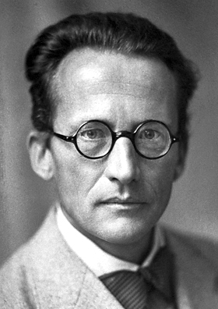
Schrodinger’s philosophy
PARTICLES can be WAVES
and WAVES can be PARTICLES
New theory is required to explain the behavior of electrons, atoms and molecules
Should be Probabilistic, not deterministic
(non-Newtonian) in nature
Wavelike equation for describing sub/atomic systems

Slide 9

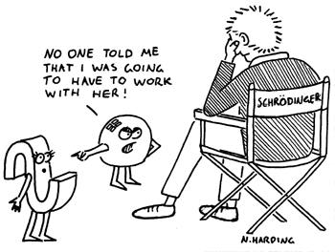
Schrodinger’s philosophy
PARTICLES can be WAVES
and WAVES can be PARTICLES
let me start with
classical wave equation
A concoction of

Slide 10

Schrodinger’s philosophy
Remember!

Slide 11
Schrodinger Equation
Time-dependent Schrodinger equation
Schrodinger equation in 3-dimensions

Slide 12
Schrodinger Equation
Time-dependent Schrodinger equation

Slide 13
Schrodinger Equation
LHS is a function of co-ordinates and RHS is function of time. If these two have to be equal then both functions must be equal to constant, say W

Slide 14
Schrodinger Equation
Separation of variables
The solution of the differential equation

Slide 15
Schrodinger Equation
In classical mechanics Ĥ represents total energy
We can therefore write
Schrodinger equation is an eigenvalue equation
There can be many solutions ψ_{n}(x) each corresponding to different energy E_{n}

Slide 16
Laws of Quantum Mechanics
The mathematical description of Quantum mechanics is built upon the concept of an operator
Classical Variable
QM Operator

Slide 17
Laws of Quantum Mechanics
The values which come up as result of an experiment are the eigenvalues of the appropriate operator
In any measurement of observable associated with operator Â, the only values that will be ever observed are the eigenvalues an, which satisfy the eigenvalue equation:
Ψ_{n} are the eigenfunctions of the system and a_{n} are corresponding eigenvalues
If the system is in state Ψ_{k} , a measurement on the system will yield an eigenvalue a_{k}

